Slide 1
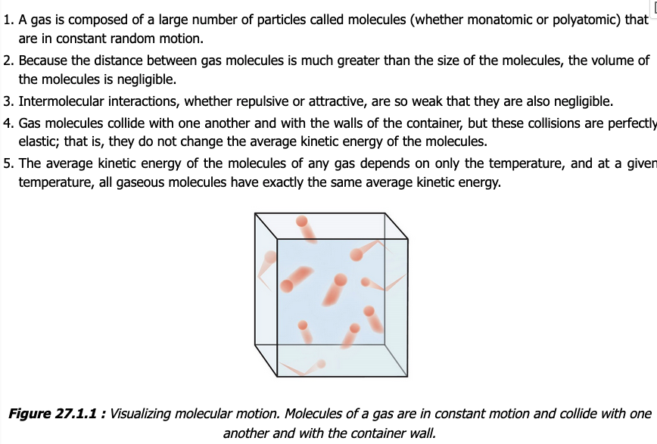
Assumptions of the kinetic-molecular theory of gases

Slide 2
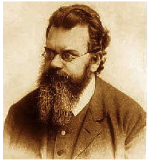
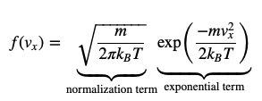
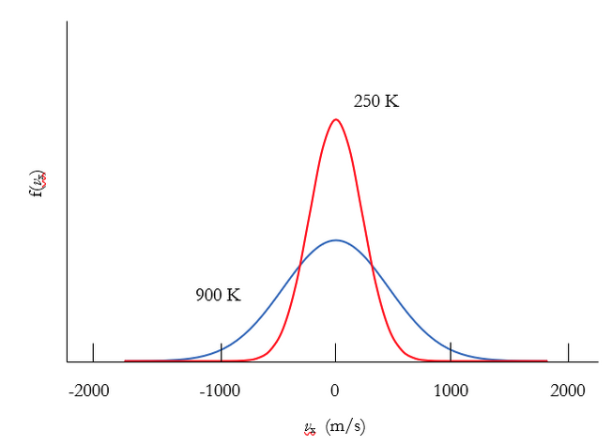
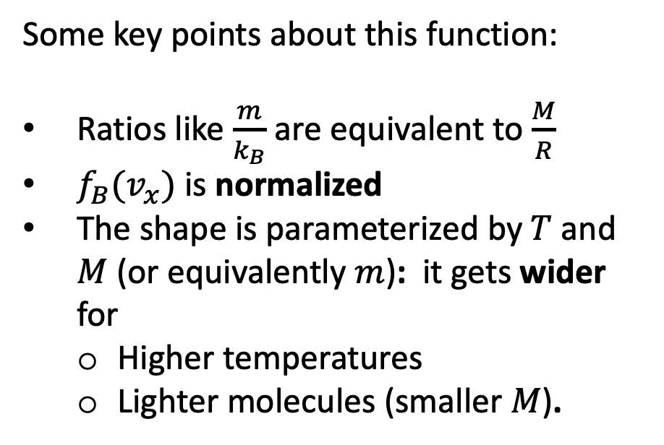
The Boltzmann Distribution (which we’re calling “$f_{B}$”)
Some key points about this function:
Ratios like $\frac{m}{k_{B}}$ are equivalent to $\frac{M}{R}$
$f_{B}(v_{x})$ is normalized
The shape is parameterized by $T$ and $M$ (or equivalently $m$): it gets wider for
Higher temperatures
Lighter molecules (smaller $M$).

Slide 3
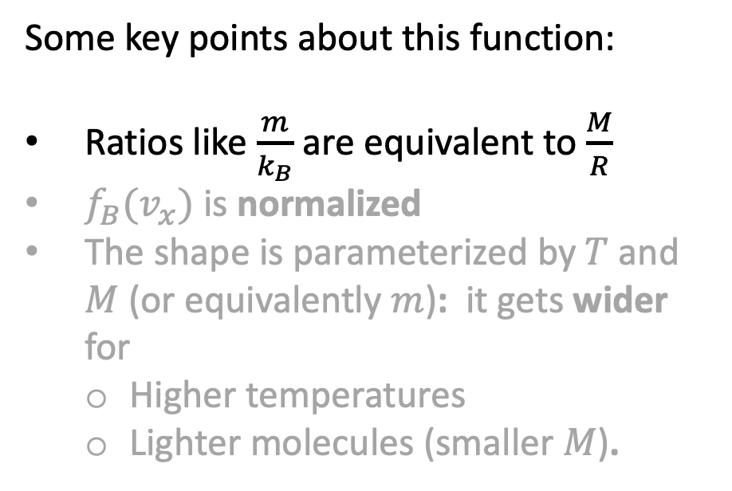
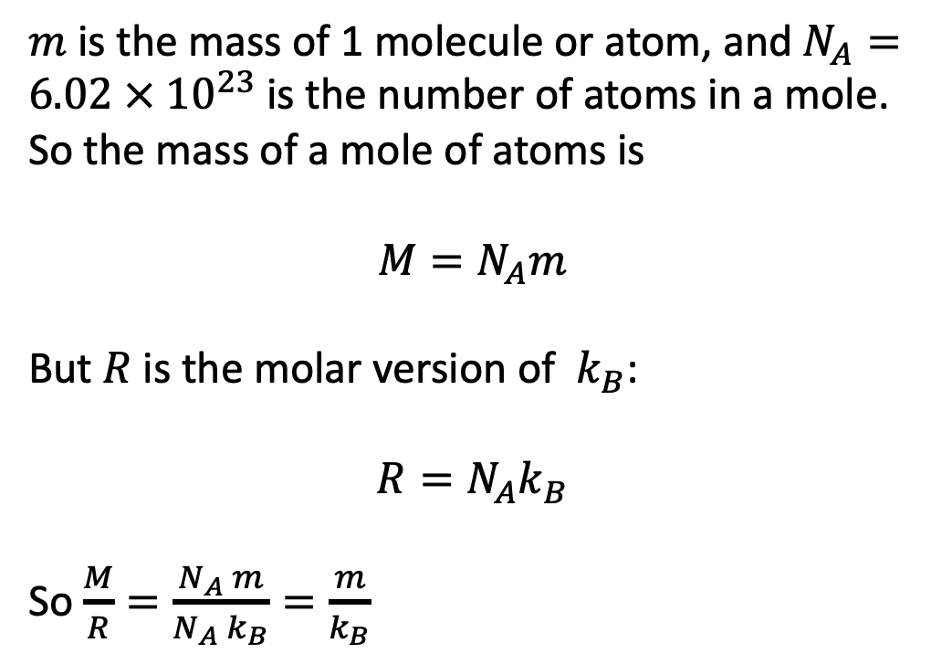
The Boltzmann Distribution (which we’re calling “$f_{B}$”)
Some key points about this function:
Ratios like $\frac{m}{k_{B}}$ are equivalent to $\frac{M}{R}$
$f_{B}(v_{x})$ is normalized
The shape is parameterized by $T$ and $M$ (or equivalently $m$): it gets wider for
Higher temperatures
Lighter molecules (smaller $M$).
$m$ is the mass of 1 molecule or atom, and $N_{A}=6.02 × {10}^{23}$ is the number of atoms in a mole. So the mass of a mole of atoms is
$${M=N}_{A}m$$
But $R$ is the molar version of $k_{B}$:
$${R=N}_{A}k_{B}$$
So $\frac{M}{R}=\frac{N_{A} m}{N_{A} k_{B}}=\frac{m}{k_{B}}$

Slide 4

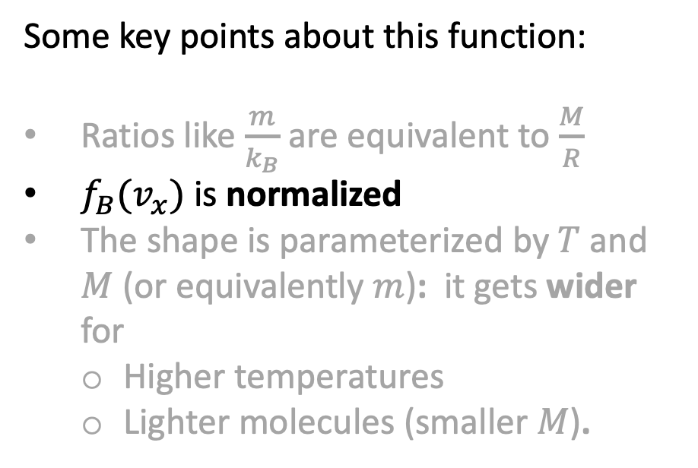
The Boltzmann Distribution (which we’re calling “$f_{B}$”)
Some key points about this function:
Ratios like $\frac{m}{k_{B}}$ are equivalent to $\frac{M}{R}$
$f_{B}(v_{x})$ is normalized
The shape is parameterized by $T$ and $M$ (or equivalently $m$): it gets wider for
Higher temperatures
Lighter molecules (smaller $M$).

Slide 5
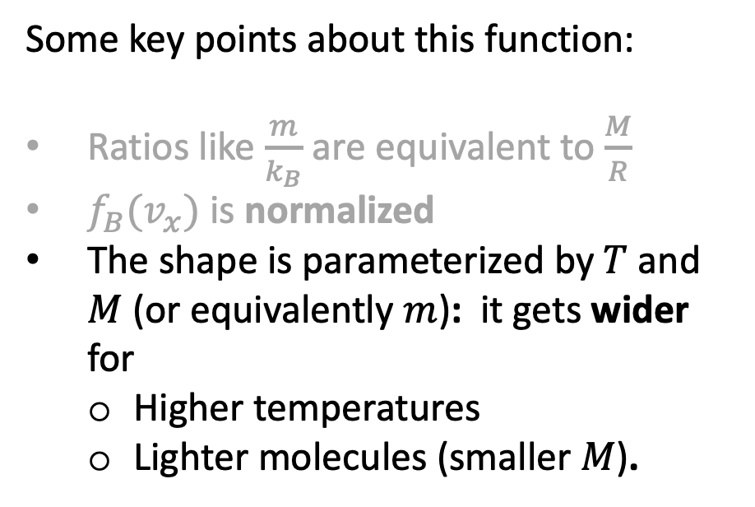
The Boltzmann Distribution (which we’re calling “$f_{B}$”)
Some key points about this function:
Ratios like $\frac{m}{k_{B}}$ are equivalent to $\frac{M}{R}$
$f_{B}(v_{x})$ is normalized
The shape is parameterized by $T$ and $M$ (or equivalently $m$): it gets wider for
Higher temperatures
Lighter molecules (smaller $M$).

Slide 6

The Boltzmann Distribution (which we’re calling “$f_{B}$”)
Some key points about this function:
Ratios like $\frac{m}{k_{B}}$ are equivalent to $\frac{M}{R}$
$f_{B}(v_{x})$ is normalized
The shape is parameterized by $T$ and $M$ (or equivalently $m$): it gets wider for
Higher temperatures
Lighter molecules (smaller $M$).
Our notation:
$$f_{B}=N_{B}\exp\left(−Dv_{x}^{2}\right)$$
$${N_{B}=\left(\frac{M}{2πRT}\right)}^{\frac{1}{2}}$$
$$D=\frac{M}{2RT}$$

Slide 7
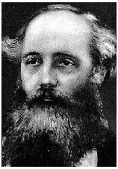

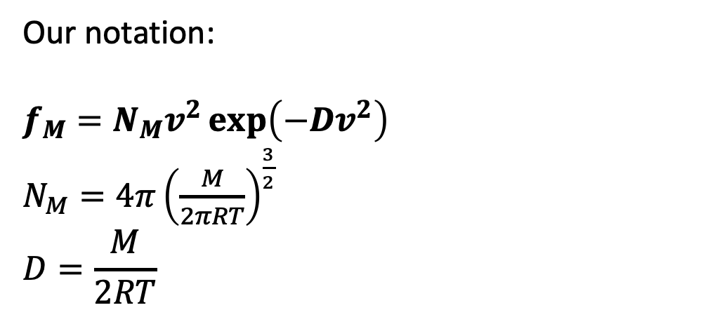
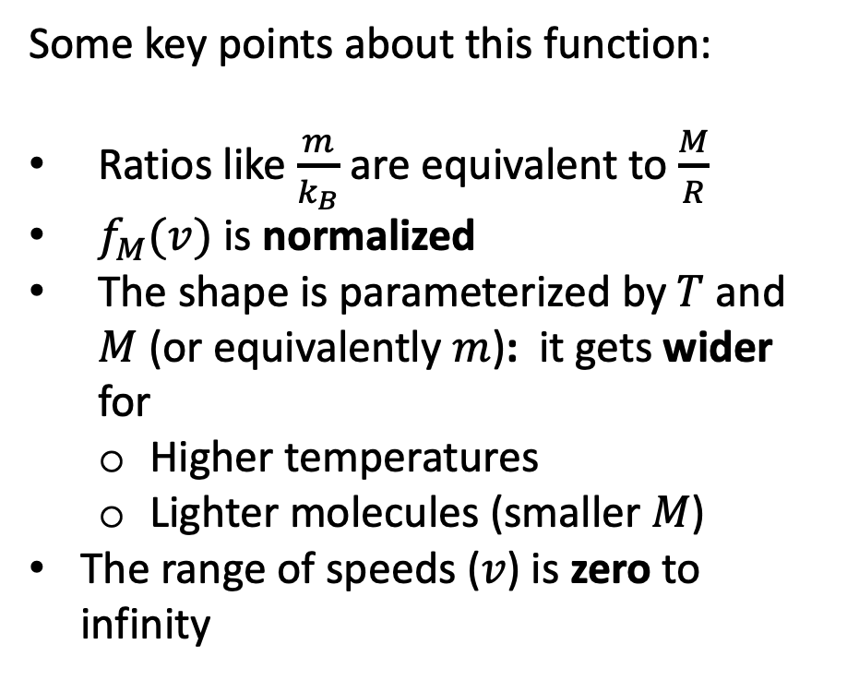
The Maxwell Distribution (which we’re calling “$f_{M}$”)
Some key points about this function:
Ratios like $\frac{m}{k_{B}}$ are equivalent to $\frac{M}{R}$
$f_{M}(v)$ is normalized
The shape is parameterized by $T$ and $M$ (or equivalently $m$): it gets wider for
Higher temperatures
Lighter molecules (smaller $M$)
The range of speeds ($v$) is zero to infinity
Our notation:
$$f_{M}=N_{M}v^{2}\exp\left(−Dv^{2}\right)$$
$N_{M}=4π{\left(\frac{M}{2πRT}\right)}^{\frac{3}{2}}$
$$D=\frac{M}{2RT}$$

Slide 8
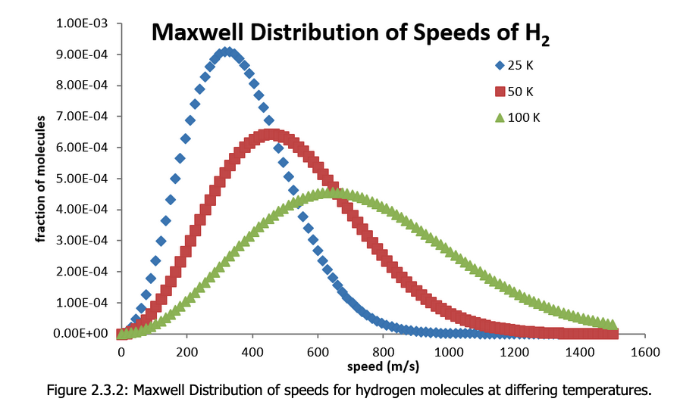
The Maxwell Distribution (which we’re calling “$f_{M}$”)
Some key points about this function:
Ratios like $\frac{m}{k_{B}}$ are equivalent to $\frac{M}{R}$
$f_{M}(v)$ is normalized
The shape is parameterized by $T$ and $M$ (or equivalently $m$): it gets wider for
Higher temperatures
Lighter molecules (smaller $M$)
The range of speeds ($v$) is zero to infinity

Slide 9

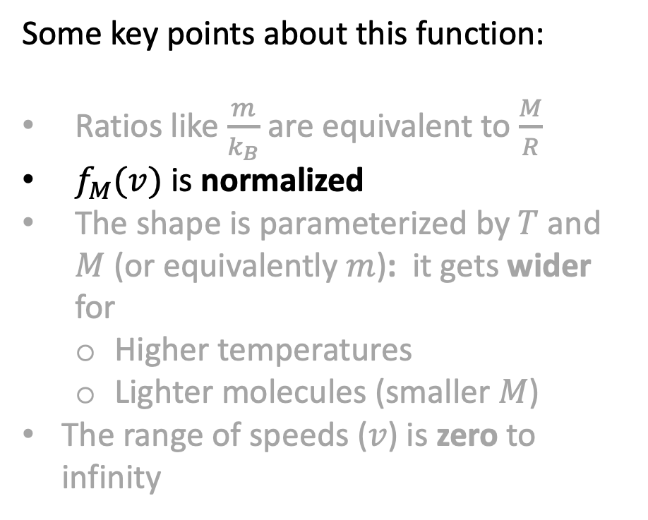
The Maxwell Distribution (which we’re calling “$f_{M}$”)
Some key points about this function:
Ratios like $\frac{m}{k_{B}}$ are equivalent to $\frac{M}{R}$
$f_{M}(v)$ is normalized
The shape is parameterized by $T$ and $M$ (or equivalently $m$): it gets wider for
Higher temperatures
Lighter molecules (smaller $M$)
The range of speeds ($v$) is zero to infinity

Slide 10
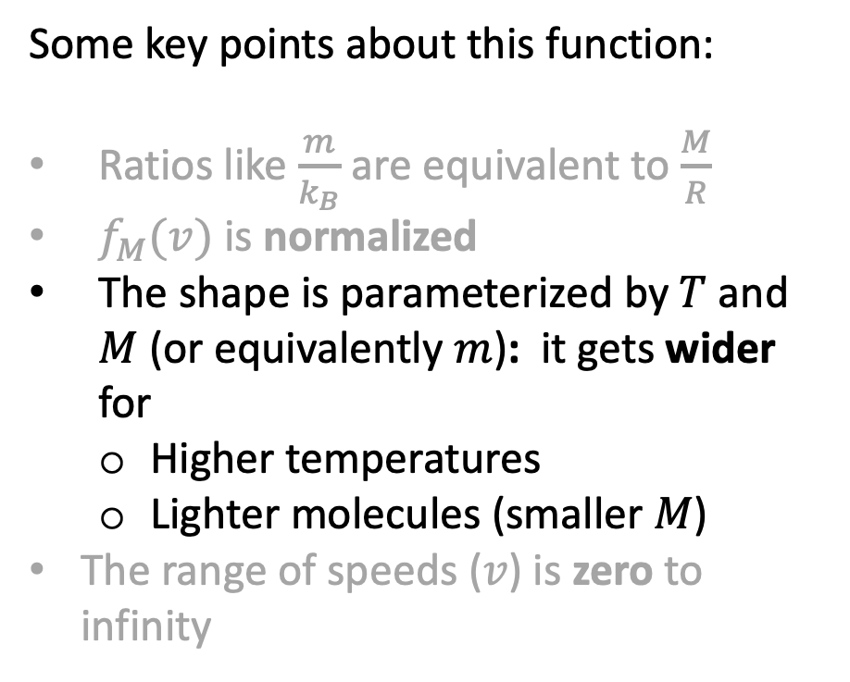
The Maxwell Distribution (which we’re calling “$f_{M}$”)
Some key points about this function:
Ratios like $\frac{m}{k_{B}}$ are equivalent to $\frac{M}{R}$
$f_{M}(v)$ is normalized
The shape is parameterized by $T$ and $M$ (or equivalently $m$): it gets wider for
Higher temperatures
Lighter molecules (smaller $M$)
The range of speeds ($v$) is zero to infinity

Slide 11
Distribution functions give us probabilities
What’s the probability of finding a molecule between 800 and and 820 m/s, when the temperature is
25 K
50 K
100 K
Probability = width x height

Slide 12
Distribution functions give us probabilities
What’s the probability of finding a molecule between 800 and and 820 m/s, when the temperature is
25 K
50 K
100 K
Prob. (100 K) > Prob (50 K) > Prob (25 K)

Slide 13
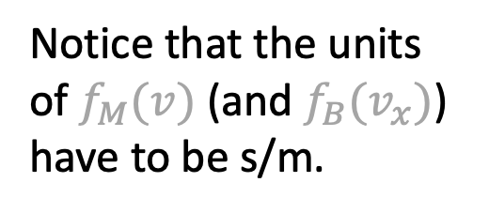
Distribution functions give us probabilities
What’s the probability of finding a molecule between 800 and and 820 m/s, when the temperature is
25 K
50 K
100 K
Notice that the units of $f_{M}(v)$ (and $f_{B}(v_{x})$) have to be s/m.
Prob. (100 K) > Prob (50 K) > Prob (25 K)

Slide 14
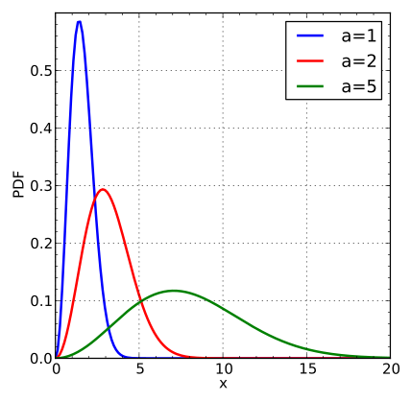

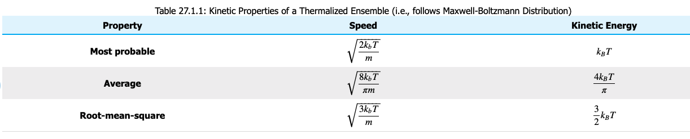


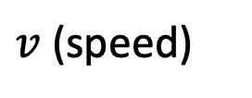




The three c’s
$$f_{M}$$
$$c^{∗}$$
$$\overline{c}= <v>$$
$$c= <v^{2}>^{1/2}$$
The $<…>$notation means “take the average of what’s inside the brackets”
$v$ (speed)
$c^{∗}<\overline{c}<c$

Slide 15

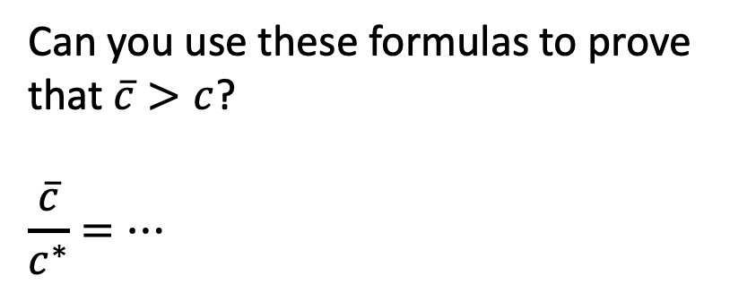


$$c^{∗}$$
$$\overline{c}$$
$$c$$
Can you use these formulas to prove that $\overline{c}>c$?
$$\frac{\overline{c}}{c^{∗}}=…$$

Slide 16
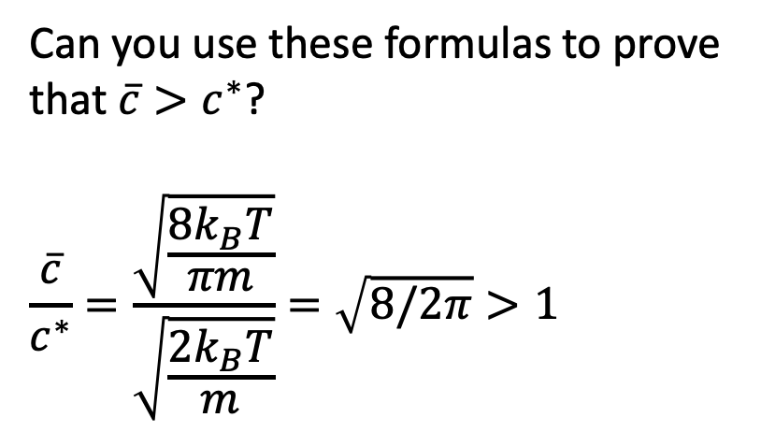
$$c^{∗}$$
$$\overline{c}$$
$$c$$
Can you use these formulas to prove that $\overline{c}>c^{∗}$?
$$\frac{\overline{c}}{c^{∗}}=\frac{\sqrt{\frac{8k_{B}T}{πm}}}{\sqrt{\frac{2k_{B}T}{m}}}=\sqrt{8/2π}>1$$

Slide 17
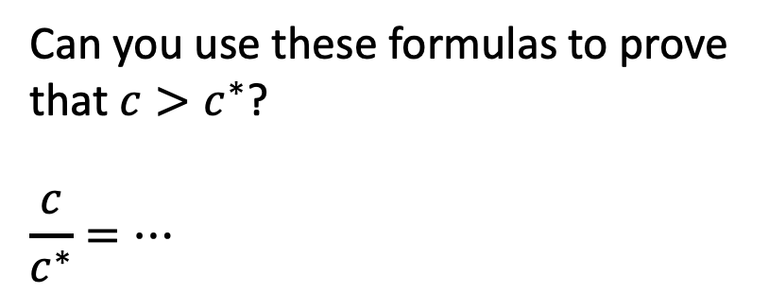
$$c^{∗}$$
$$\overline{c}$$
$$c$$
Can you use these formulas to prove that $c>c^{∗}$?
$$\frac{c}{c^{∗}}=…$$

